Slide 1
Image Classification using AWS
Trina Sahoo(1901254)
Debodeep Banerjee (1901253)

Slide 2
Introduction
The motive of this project is to perform a classification task with Amazon Web Service. There are two parts of this project: the first part is the model development and the second part is the deployment and testing of the model. The problem considered is forest fire classification. The dataset is collected from the website, splitted the dataset into train, test and validation data.
The model trained on the dataset is done in the local machine and use docker to form a container and pushed the necessary files in AWS ECR. In the next phase we have deployed the trained model as a cloud web application using AWS EC2 service.

Slide 3
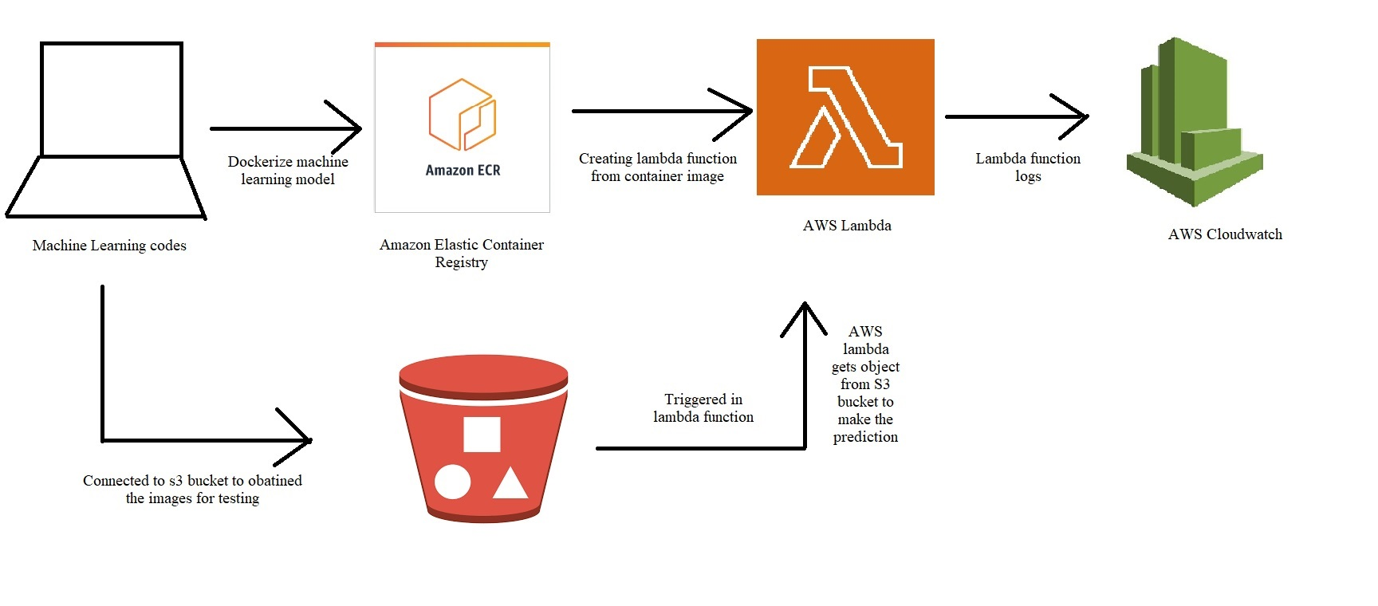
Development of the Model
In the first part of the project we will discuss about the development of the model. The model is trained with the pretrained model Xception with the weight imagenet. After training the model in the local machine, we have packaged the code and dependencies as a container image using Docker and upload the image to AWS ECR.

Slide 4
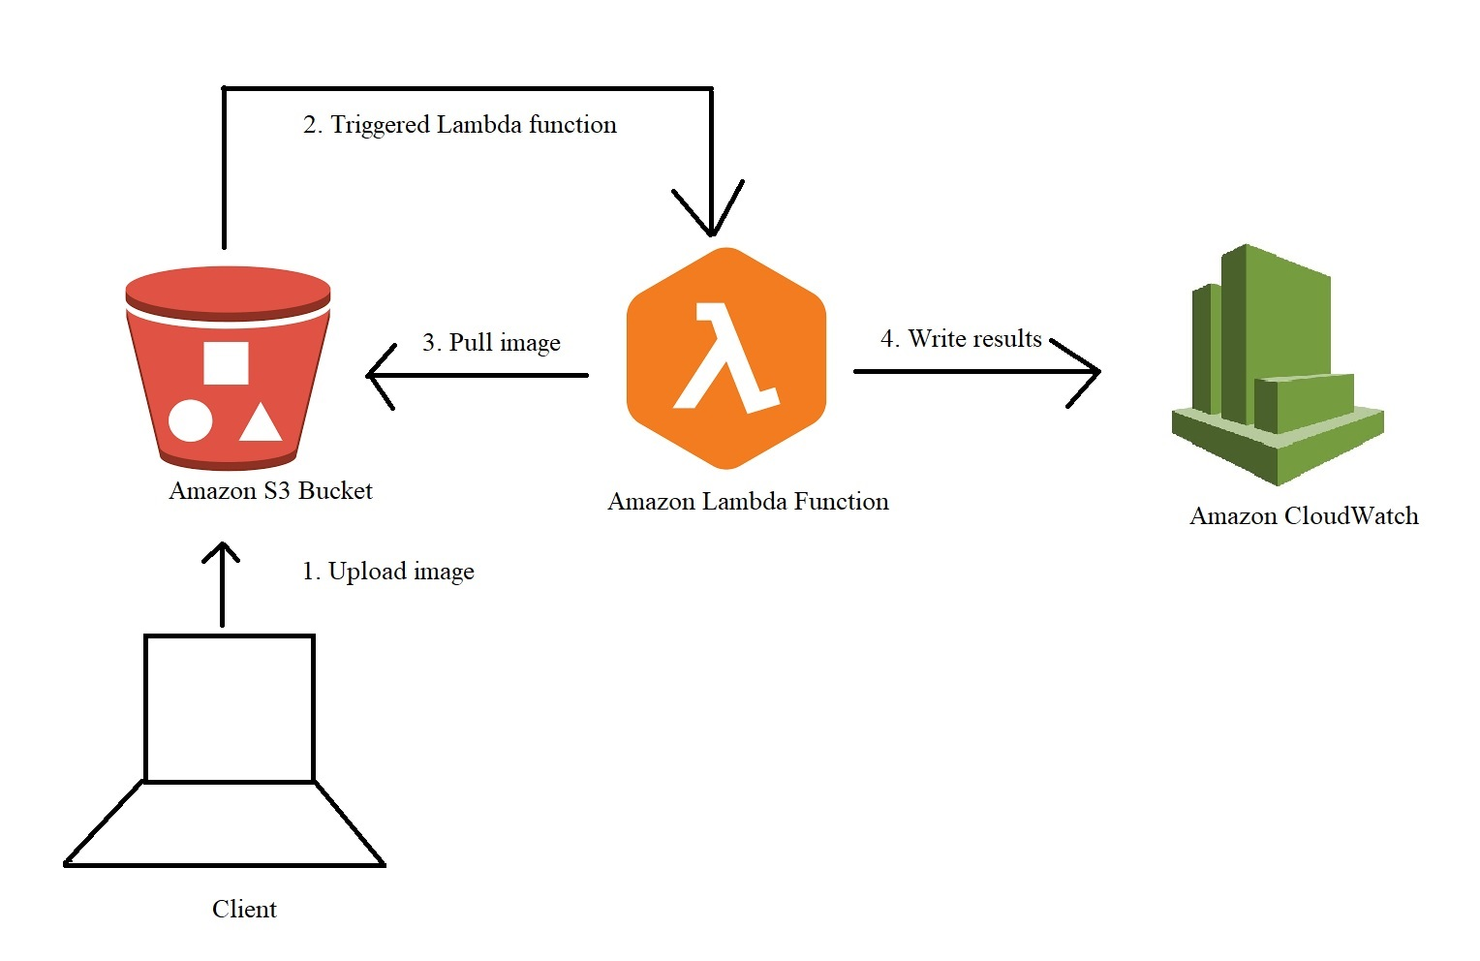
Deployment in AWS Lambda
In order to deploy the trained model we have the following steps:
On the local machine, we have created a folder which contains lambda_function.py, requirement.txt and Dockerfile.
The inference function in lambda_function.py needs a specific structure to be invoked by the lambda runtime. After making all the files we have pushed the container image to ECR.

Slide 5
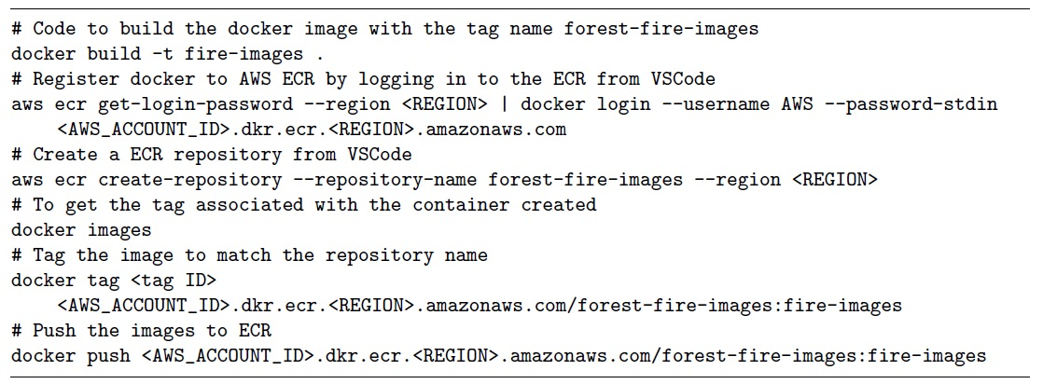
Deployment in AWS Lambda

Slide 6
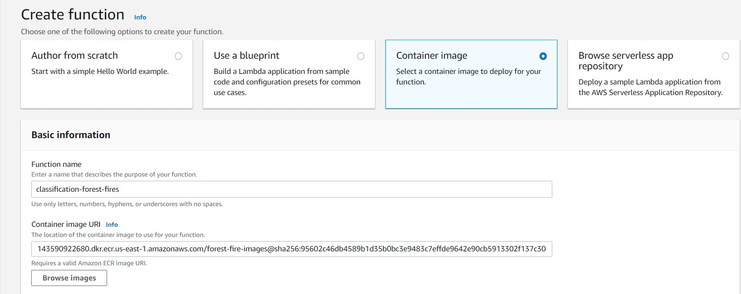
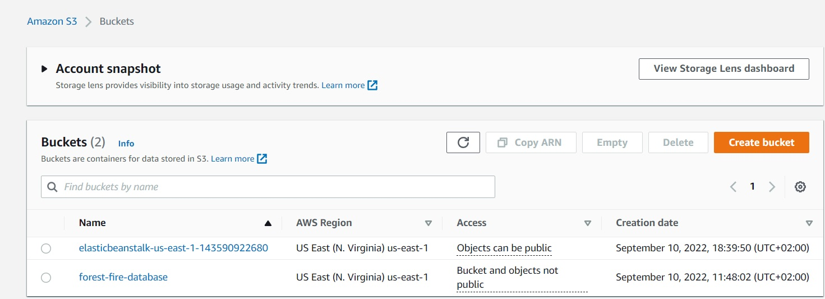
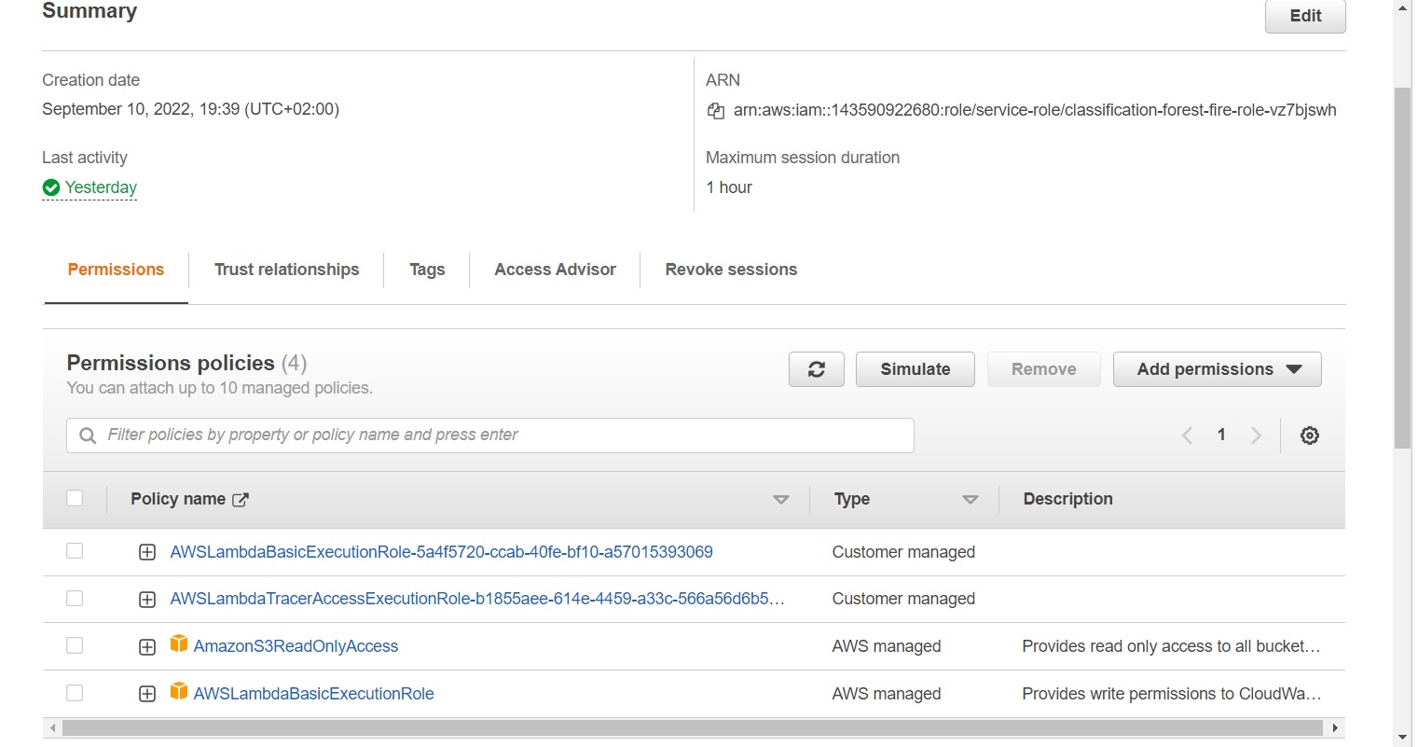
Deployment in AWS Lambda
The next task is to create the S3 bucket, Lambda function and trigger the S3 bucket in the Lambda function.
After the trigger is added to the Lambda function we need to allow the Lambda function to connect to the S3 bucket by setting the appropriate AWS identity and access management (IAM) rights for its execution role. The policies attached are: AmazonS3ReadOnlyAccess and AWSLambdaBasicExecutionRole

Slide 7
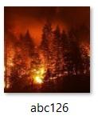
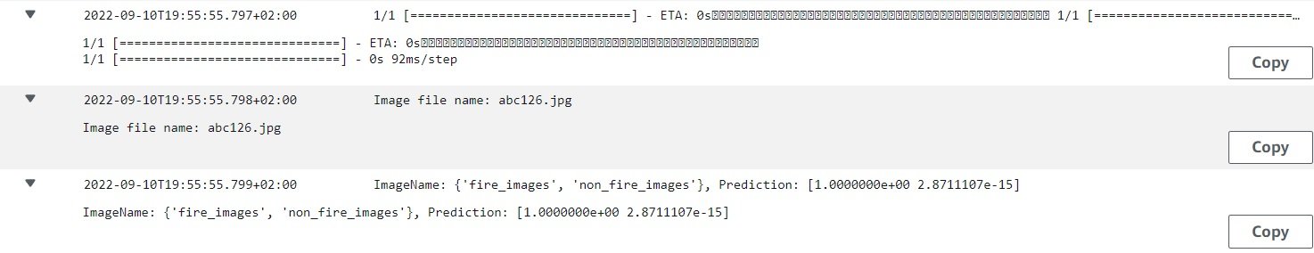
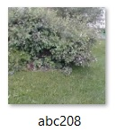
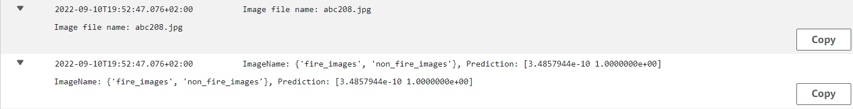
Testing in AWS Lambda
In order to test, we have to upload an image in the s3 bucket. After uploading the image in the S3 bucket, in a few moments we can see the result of the prediction in the CloudWatch logs. We will get the predicted image class with the probability.

Slide 8
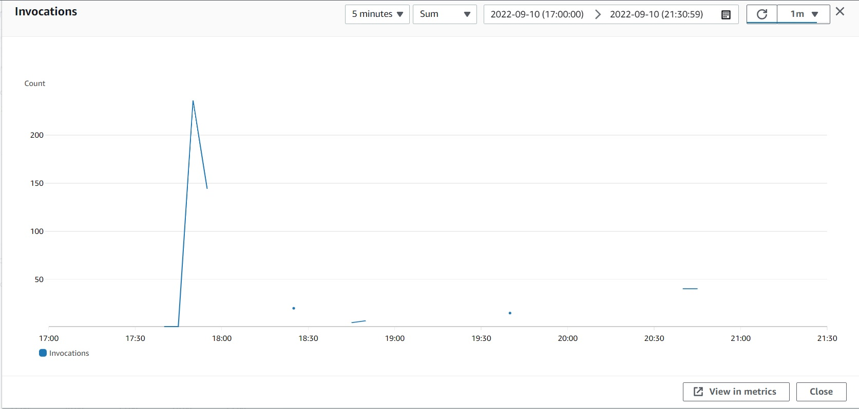
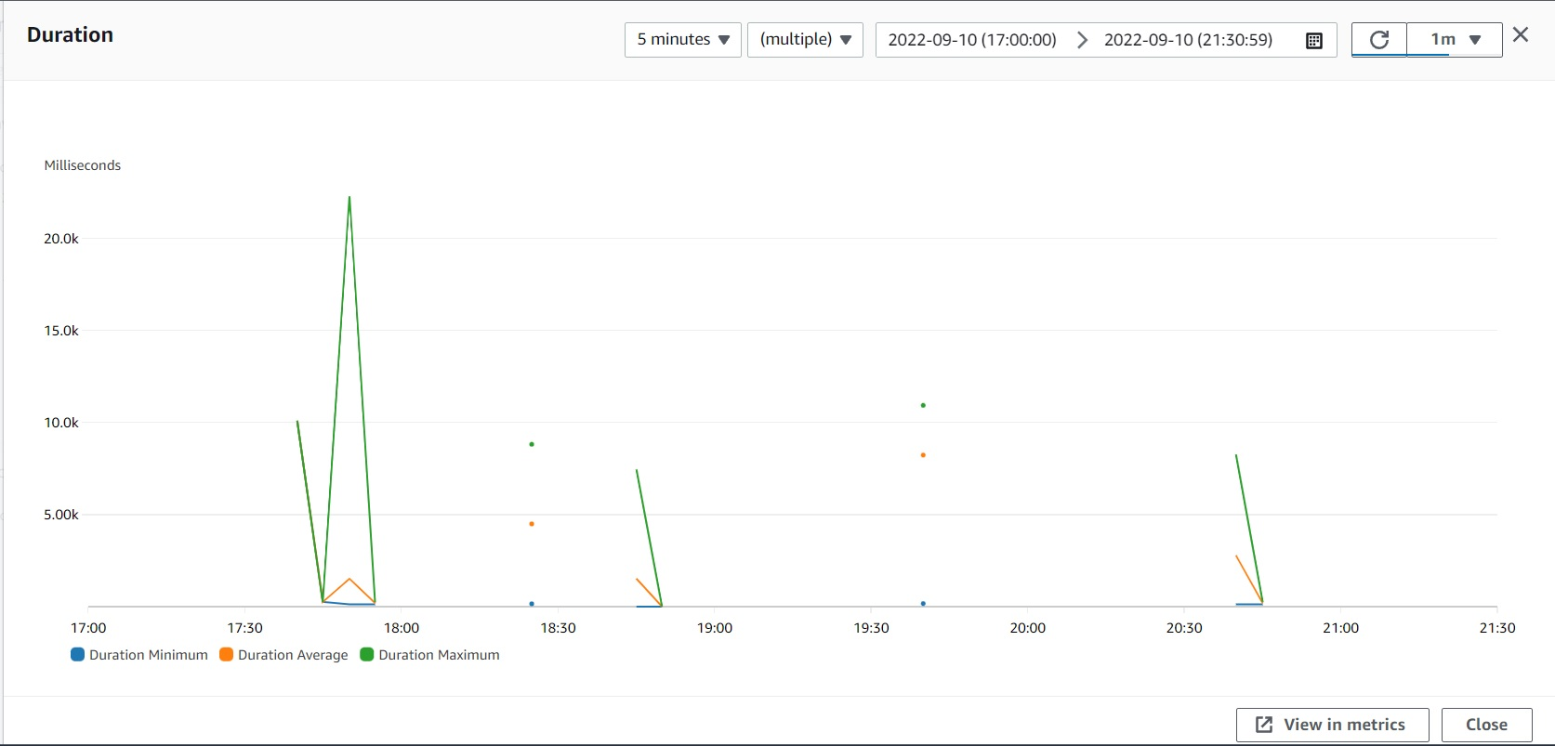
Experimental results
The metrics obtained from AWS Lambda are invocation, duration, concurrent execution, error rate and success rate and the cloudwatch logs.
Invocation: In the invocation metrics, it is shown that the number of times a function is invoked. In the below picture the peak number of invocation is noted as 236.
Duration: It shows the amount of time taken for a lambda function. In our case most of the time it takes maximum duration.

Slide 9
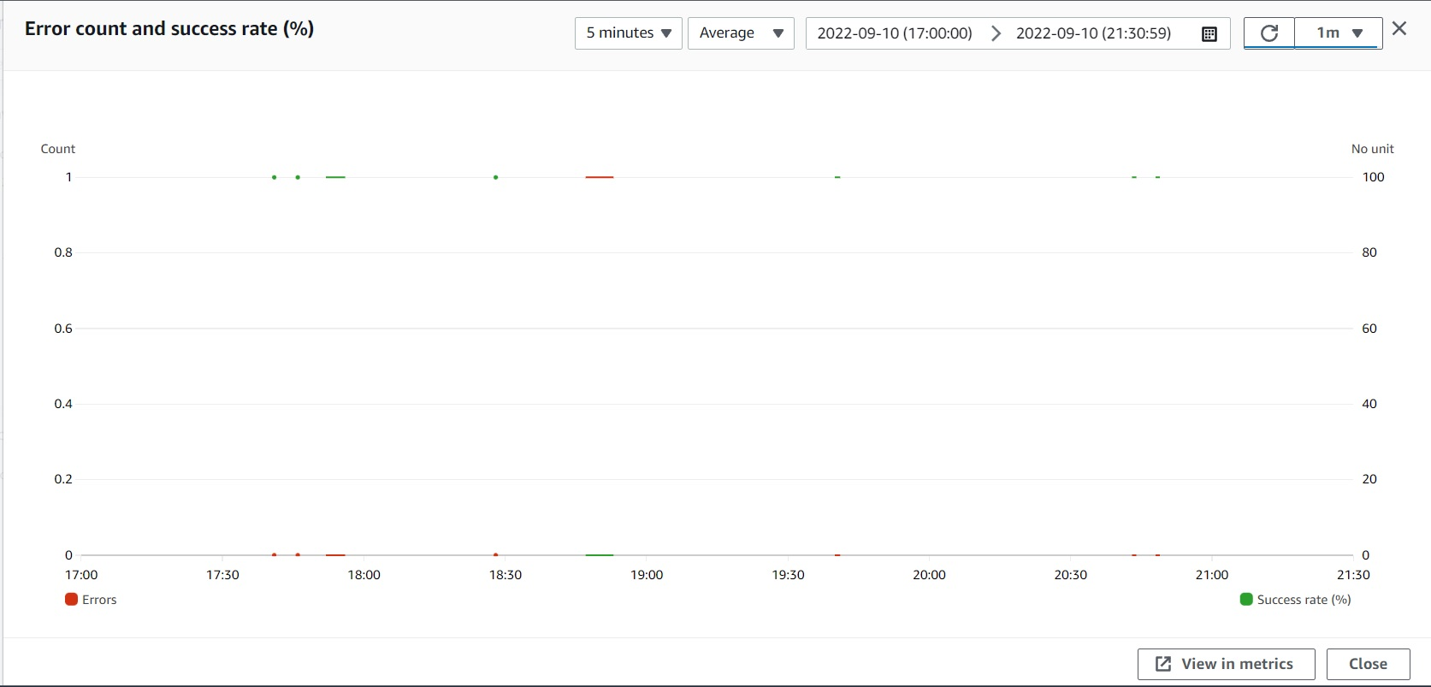
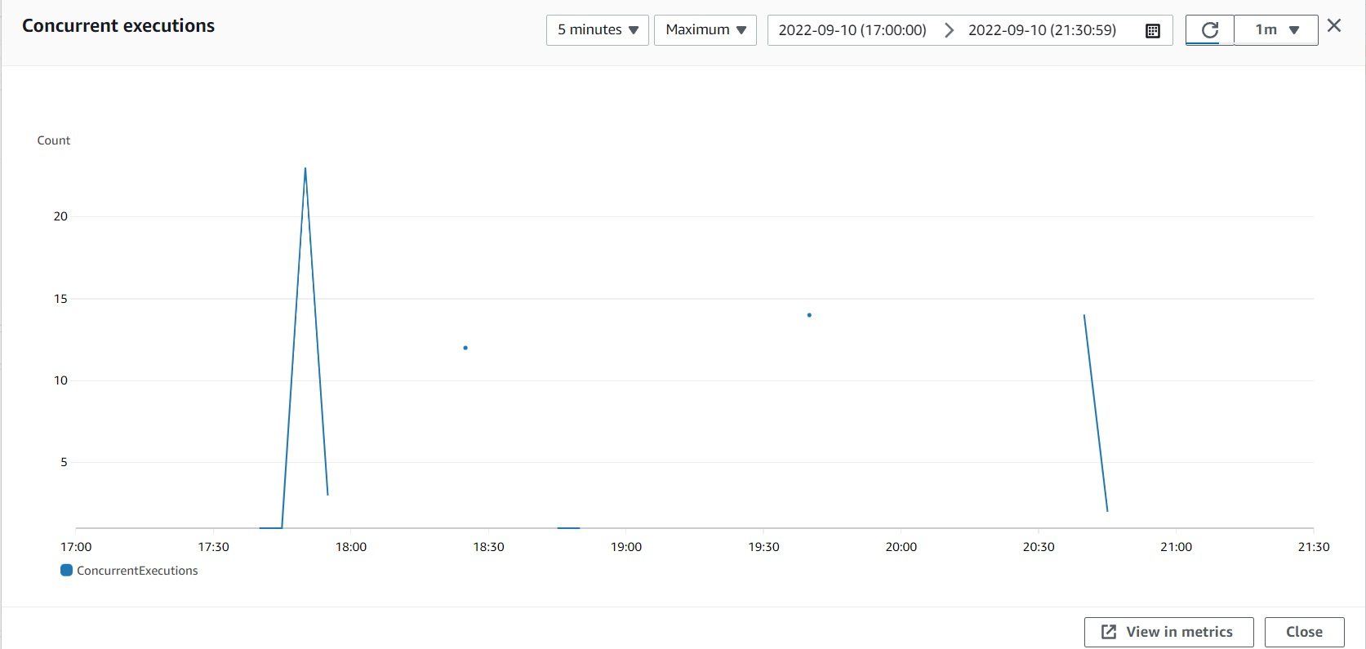
Experimental results
Error rate and success rate: It monitor the number of errors and successful attempts thrown by the lambda function.
Concurrent Executions: The number of executions of our function code that are happening at any given time.

Slide 10
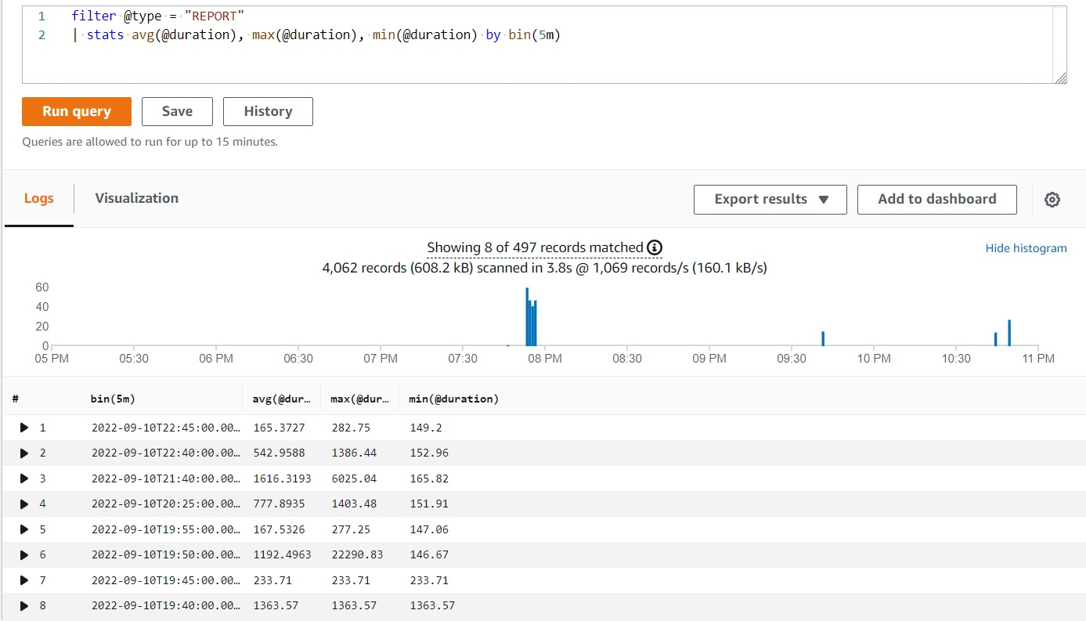
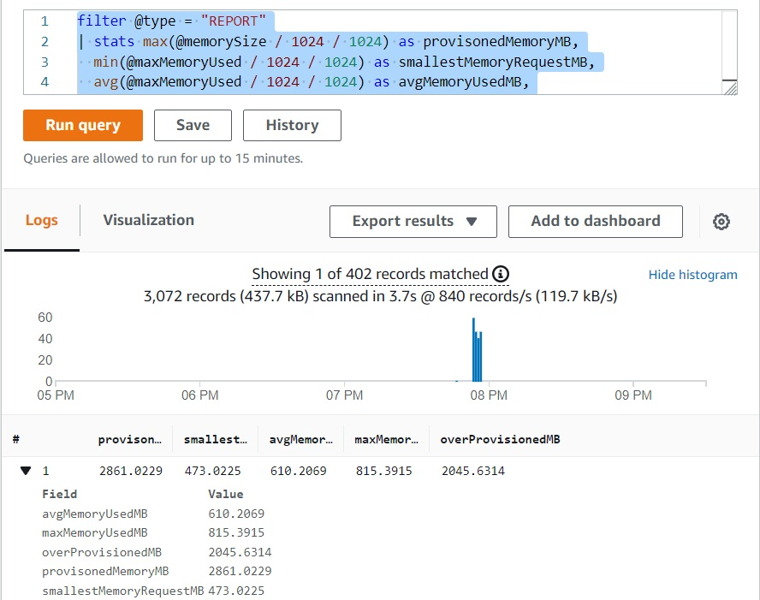
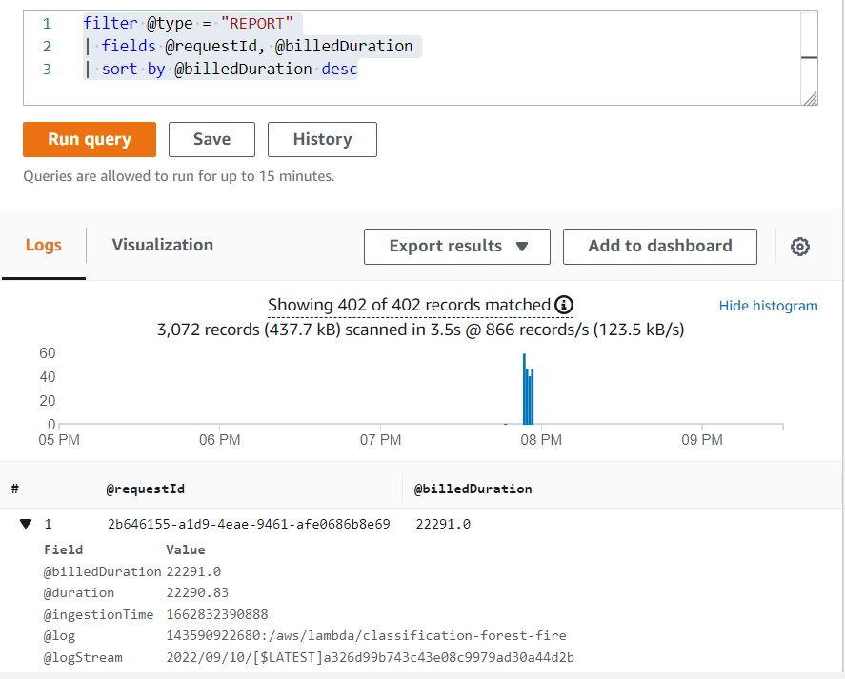
Experimental results
CloudWatch Logs: Lambda automatically stream details about each function invocations, along with logs, and other output from the function’s code to CloudWatch Logs. In the Log Insight, we run sum queries to get some insights:
View the latency statistics for 5 minutes:
Determine the amount of over provisioned memory:
Find the most expensive requests:

Slide 11
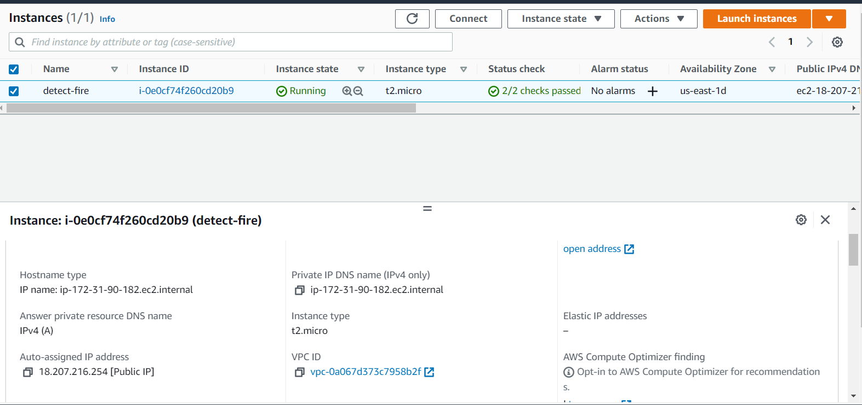
Web Application launch using EC2
In this part we will discuss about hosting the application using Amazon EC2 . For a successful deployment, we followed the following steps.
Launch an instance in EC2.
The EBS storage has been set to 8 gb.
In order to conduct a successful deployment from the ubuntu to the EC2 instance, we have used two other tools, viz. Putty and Winscp.
The ubuntu version is chosen as 18.04

Slide 12
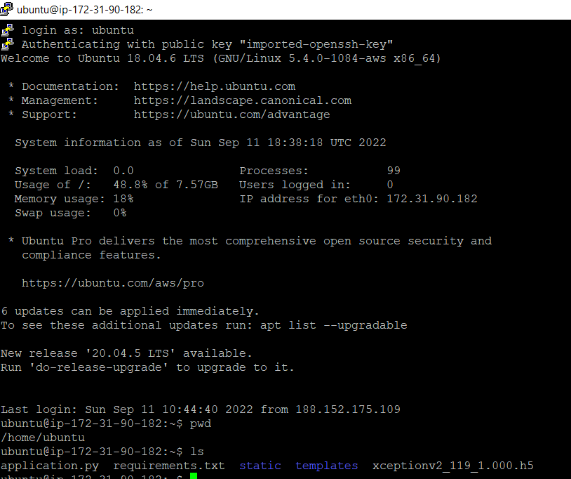
Web Application launch using EC2 (Continued)
The virtual machine contains all the necessary files for the process. for our purpose, the files are as follows:
application.py- Main code using the Flask app for the web application.
Template - A folder contains the index.html file.
static: Folder contains the necessary images.
requirements.txt - A text file contains the necessary packages.
Model - The trained model is stored as a .h5 file.

Slide 13
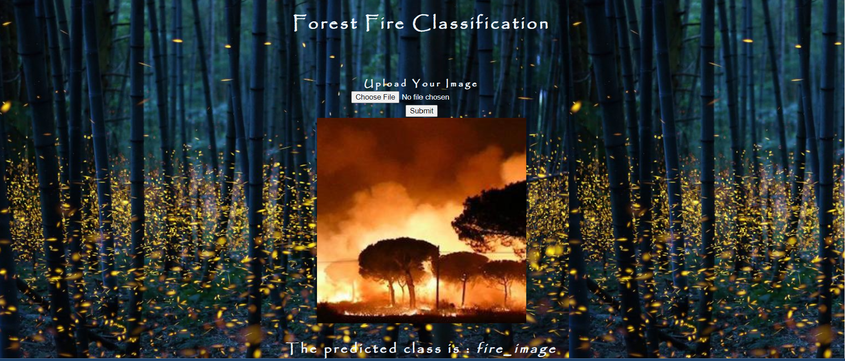
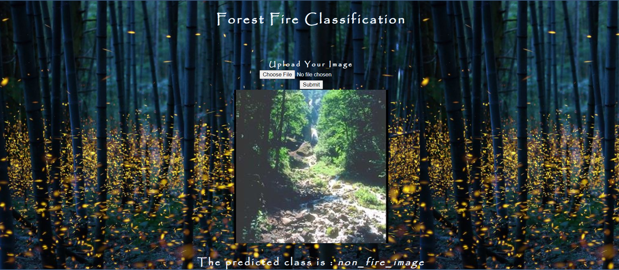
The Web Application

Slide 14
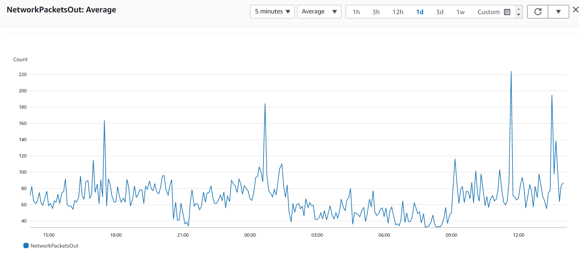
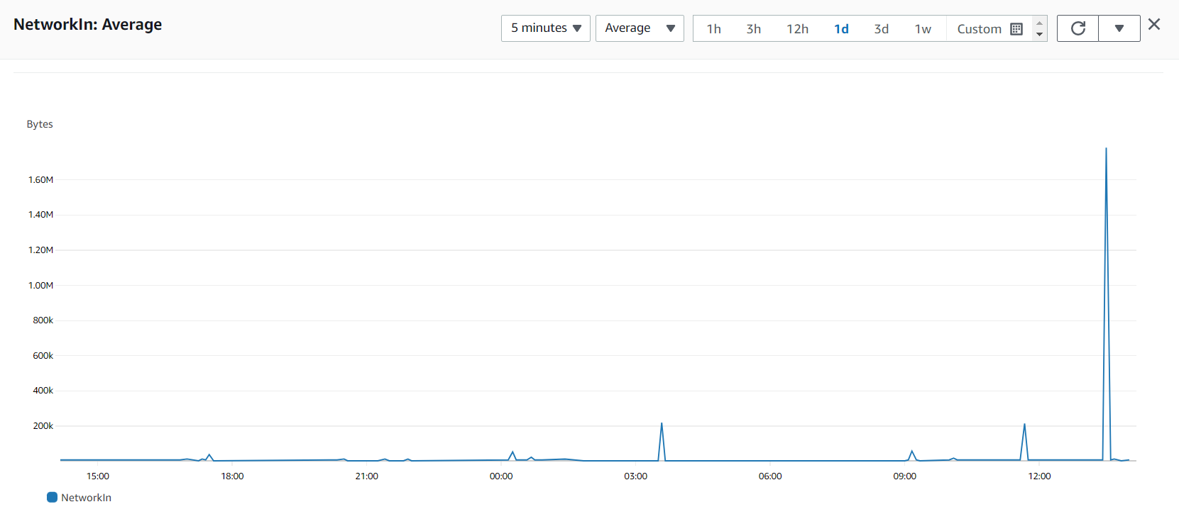
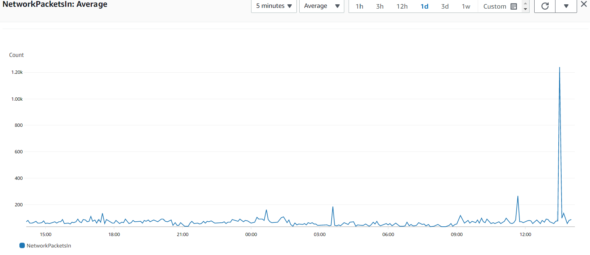
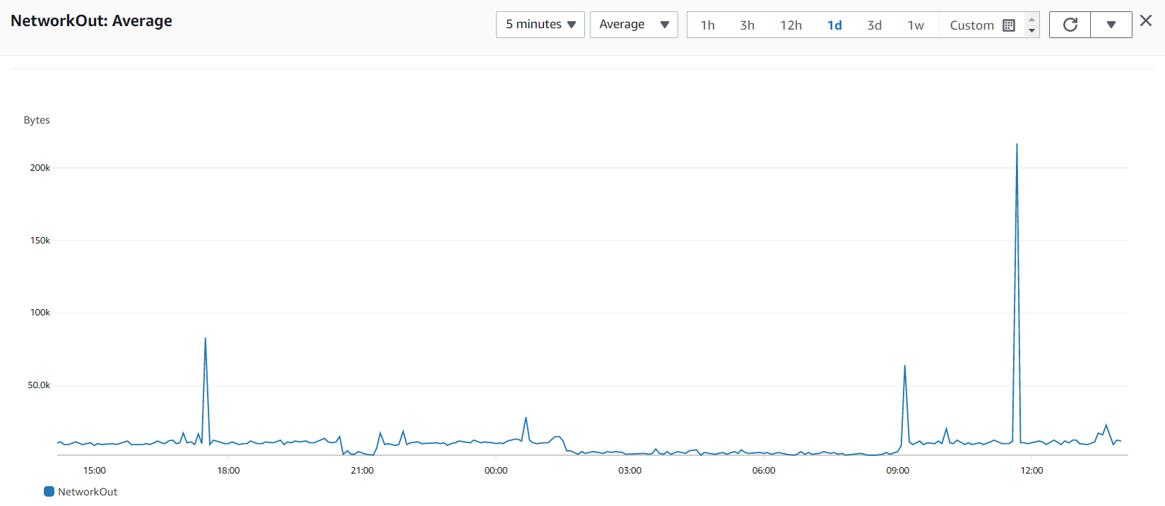

Slide 15
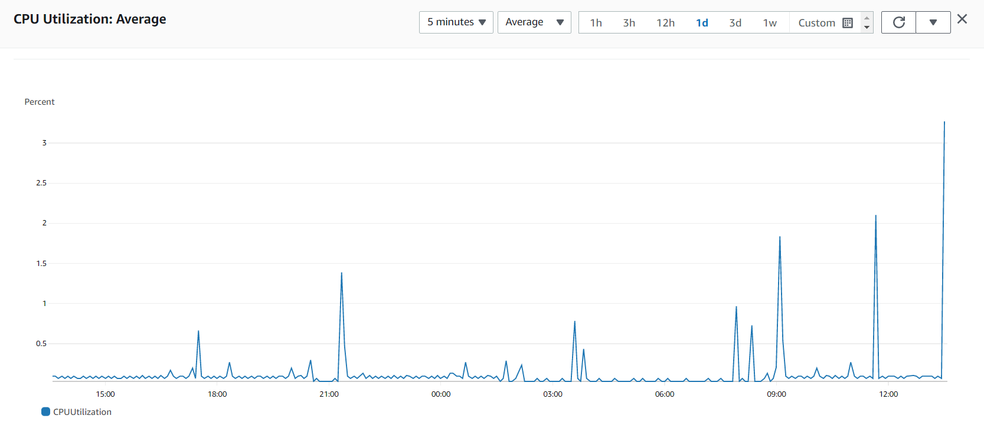
Cloud watch: CPU Utilization

Slide 16
Conclusion
In this project we have considered the forest fire data and it was an image classification task. The first part of the project is to deploy the model as a container image in the AWS Lambda and the next part of the project is to deploy the model as an EC2 instance in order to form a website. After the deployment we have tested in both the cases with a new Test dataset that has been formed previously. We have also shown some metrics involved with the function and the instance created such as invocation, duration, error rate and success rate and concurrent execution for the lambda function and for the EC2 instance CPU utilization, Network and Network package and Load balancer.

Slide 17
Reference
Using container images to run TensorFlow models in AWS Lambda
AWS Documentation
Website
http://ec2-18-207-216-254.compute-1.amazonaws.com:8080/

